Slide 1



A Compositional Approach
to Coordinated Software Rejuvenation
of Component-Based Systems
Leonardo Paroli
Tommaso Botarelli
Laura Carnevali
Enrico Vicario
Software Technologies Lab,
University of Florence, Italy
Use of micro-rejuvenation strategies in component-based systems to mitigate software aging.
Modeling the system as a static fault tree and components as MRGPs for compositional unavailability analysis.
Minimizing unavailability through coordinated phasing of micro-rejuvenation of components.
Definition of a complementary macro-rejuvenation policy to mititgate synchronization loss over time.
Notes:
“Good [morning/afternoon], everyone thanks for the introduction and and to all who are attending this presentation. I’m Leonardo Paroli, i’m currently enrolled as a Ph.D student on Smart Computing at the University of Florence in Italy. Today, I’m going to talk about a compositional approach to coordinated software rejuvenation in component-based systems. As we know, software systems are becoming increasingly complex and are required to maintain high levels of reliability while handling this growing complexity. Rejuvenation strategies are critical in addressing issues related to software aging, and our work introduces a method for modeling and optimizing these processes.”

Slide 2

What is software aging?
Accumulation of software aging effects
Software aging: accumulation of errors.
software failure rate
software failure
Recovering a system after a failure is costly.
performance degraded and software compromised
Problem mitigation: redundancies and synchronization.
normal execution with proper use of resources
time
Software failure rate.
Paroli, Botarelli, Carnevali, Vicario ISSRE 2024
Notes:
So, first of all, just for the sake of the presentation, i’d like to talk about sotware rejuvenation. In particular, to explain rejuvenation we must first understand software aging. As in figure, the accumulation of defects and errors ina software can lead to decreased performance as the software goes more and more compromised, until the invetable failure of the system. Recovering a system after a failure is usually costly, so we don’t want this.

Slide 3
What is software rejuvenation?
rejuvenation
rejuvenation
rejuvenation
Proactive maintenance like rejuvenation (or regeneration) mitigates software aging.
software failure rate
Rejuvenation is cheaper than recovery.
It introduces more complexity.
time
Software failure rate, with rejuvenation.
Paroli, Botarelli, Carnevali, Vicario ISSRE 2024
Notes:
Here’s where software rejuvenation comes into place, as a proactive maintanance method it restores the software into its nomianal state, eliminating software errors and defects accumulated over time. This mitigates the problem, as rejunevation is generally cheaper then recovering a failed system. .
However, sthis introduces some complexity as such maintenance activities can temporarily reduce system availability, leading to a trade-off between proactive maintenance and system downtime.

Slide 4

Towards the system model
Predictive analysis of complex systems is often unfeasible due to the dimension of the resulting model.
Number of interactions, functionalities and inner mechanisms are often the cause.
We consider systems that can be naturally decomposed into independent sub-components.
System
1
4
2
3
components
Paroli, Botarelli, Carnevali, Vicario ISSRE 2024
Notes:
First, is the system model: as system grow ever more complez, their analysis often grows unfeasible, and this is because of the complexity of the system and its inner mechanisms. WE focus on systems that can be naturally decomposed in independent sub-components, or for simplicity components,

Slide 5
Component Model
Ok
Each component, at ant given time, can be in a single state:
Ok state: component is performing normally.
Error state: component has collected one or more errors.
Down state: errors manifested a fault, which stops the component from performing normally.
Detected state: fault has been detected and is being repaired.
Error
Detected
Down
State automata of the component.
Paroli, Botarelli, Carnevali, Vicario ISSRE 2024
Notes:
Each component can be modeled through a state automata, with the ok state being the component operating normally, the Error state for when the components starts accumulating errors, the Down state when those errors becomes a fault that stops the component from operating, and we can imagine eachc component also having a self.repair mechanism to detect and repair a fault.

Slide 6

Component Model
Ok
Components are able to perform proactive maintenance: we call this micro-rejuvenation.
Rejuvenation state: restart or maintenance to restore the component to a nominal state.
Periodic rejuvenation (clock).
Down & Detected states inhibit rejuvenation (and its clock).
clock
Error
Detected
Rejuvenation
Down
State automata of the component, with rejuvenation mechanism.
Paroli, Botarelli, Carnevali, Vicario ISSRE 2024
Notes:
This suffers from the former problem of software aging, so we add a rejuvenation mechanism, which periodically, through a clock, regenerates the component, returning it to an OK state.

Slide 7
Component Model
Ok
Rejuvenating all components at the same time makes the entire system unavailable.
Desynchronization of rejuvenations lowers unavailability.
Same rejuvenation period for each component.
Different offsets for each component.
clock
Error
Detected
Rejuvenation
∆
Down
offset
State automata of the component, with rejuvenation mechanism, and offset.
Paroli, Botarelli, Carnevali, Vicario ISSRE 2024
Notes:
If all the components of a system regenerate at the same time, the system becomes unavailable, simple as that .
So, we add an offset mechanism to start the first rejuvenation with a delay

Slide 8
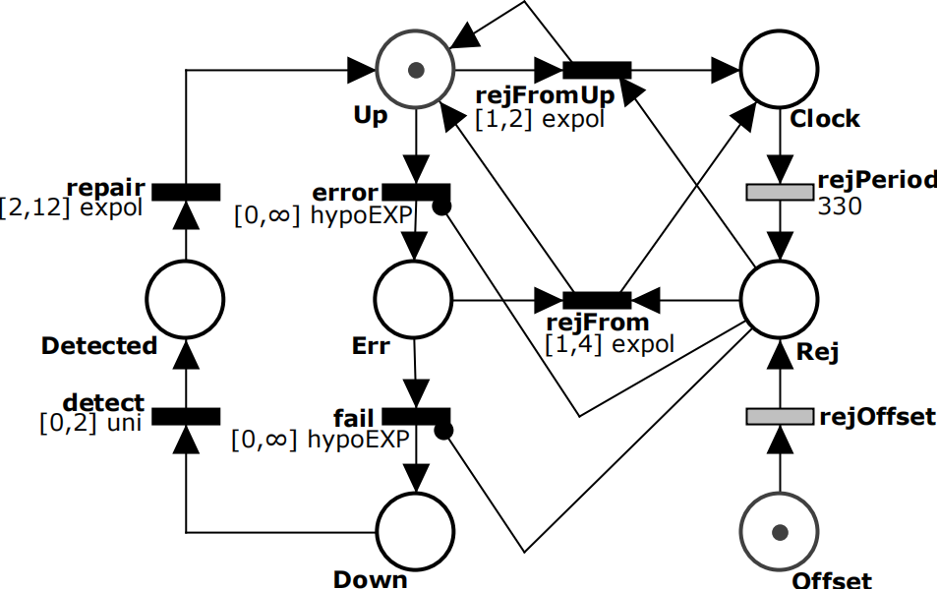
Component Model
This model is compatible to be represented as a Markov Regenerative Process (MRGP) ...
... and again, this can be represented through a Stochastic Timed Petri Net (STPN).
STPN of the component MRGP model.
Paroli, Botarelli, Carnevali, Vicario ISSRE 2024

Slide 9
Component Model
The Clock forces a regeneration periodically, if the system is not down or under repair.
Clock is disabled until the Offset has fired.
STPN of the component MRGP model.
Paroli, Botarelli, Carnevali, Vicario ISSRE 2024

Slide 10
Component Analysis
Component
Each component is analysed in isolation.
Unavailability is derived by the expected value of reward:
Down + Detected > 0 || Rej > 0
STPN of the component MRGP model.
Paroli, Botarelli, Carnevali, Vicario ISSRE 2024
Notes:
Our first contribution is the compositional analysis of the system in order to evaluate its unavailability. As previously described, we can model each component as a Markov ReGenerative Process, as shown in the Petri Net to the right, and this in Figure,

Slide 11
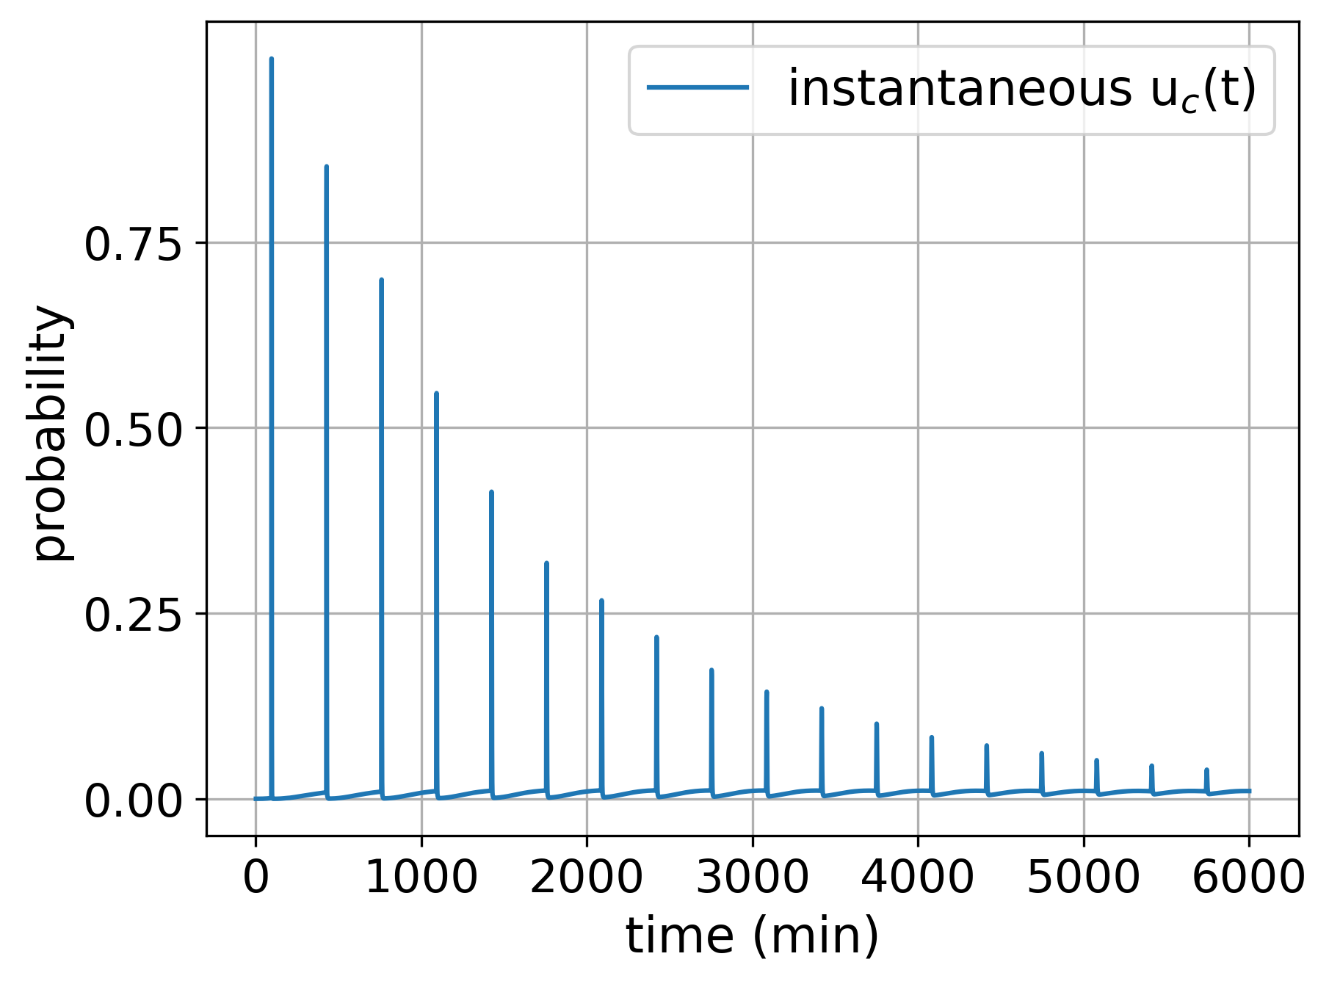
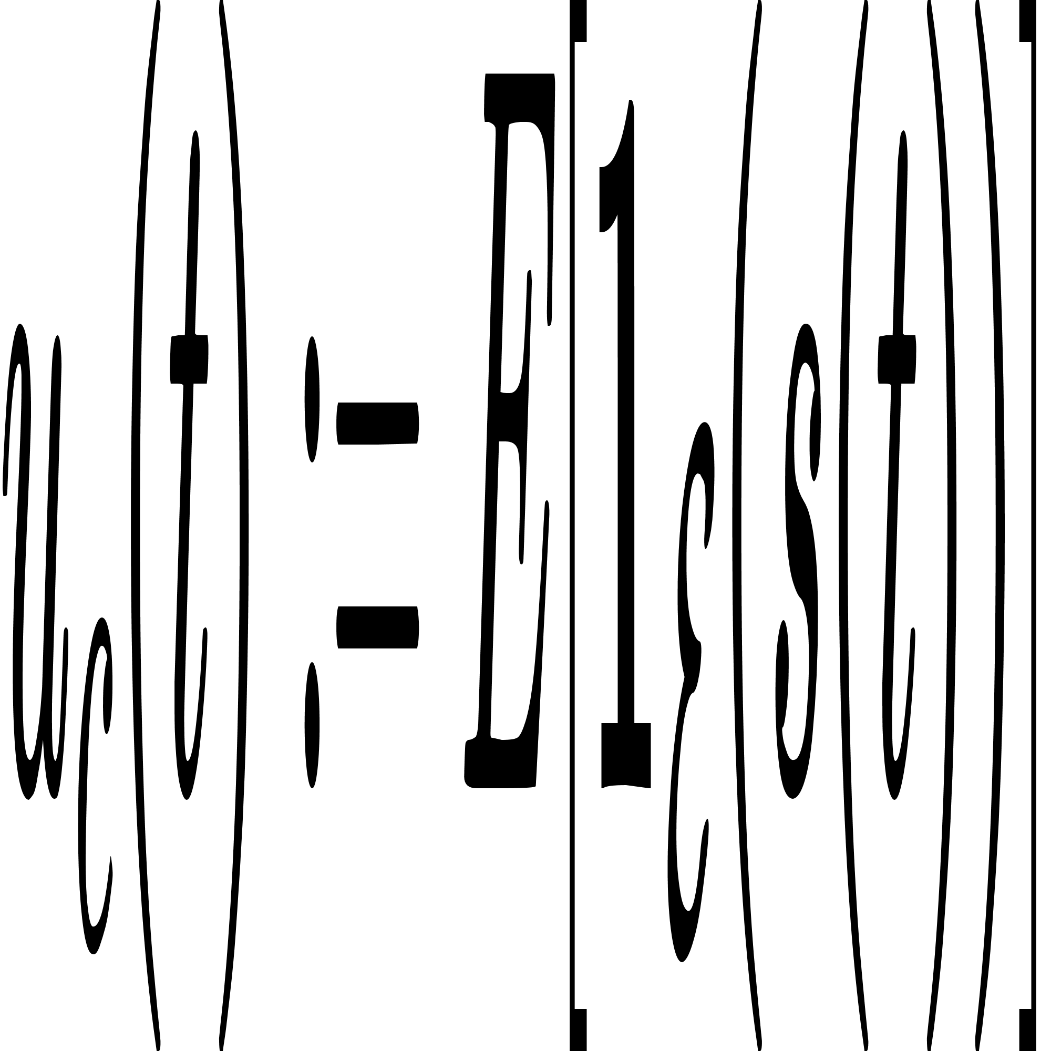
Component Analysis
Instantaneous unavalability of the component is defined as:
u_{c}(t) is calculated using the Sirio library of the ORIS tool **, through a regenerative transient analysis on the component.
where ɛ = {failure} is a set made of the system failure state,
1 is the indicator function of set ɛ,
and s(x) ∈ {failure, . . .} is the state of the system at time x.
Instantaneous unavailability of the component.
** https://www.oris-tool.org/, https://github.com/oris-tool/sirio
M. Paolieri, M. Biagi, L. Carnevali, and E. Vicario, The ORIS Tool: Quantitative Evaluation of Non-Markovian Systems, IEEE Trans. Softw. Eng., May 2019
Paroli, Botarelli, Carnevali, Vicario ISSRE 2024

Slide 12
Component Analysis
Peaks in the u_{c}(t) are due to the periodic micro-rejuvenation of the component.
On the long run, the component eventually reaches a steady state (i.e u_{c}(t) converges to a single value).
Instantaneous unavailability of the component.
Paroli, Botarelli, Carnevali, Vicario ISSRE 2024

Slide 13
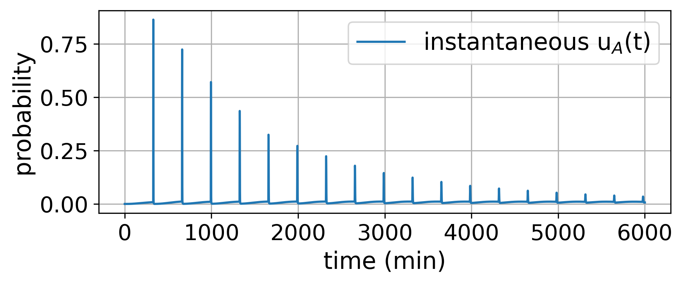

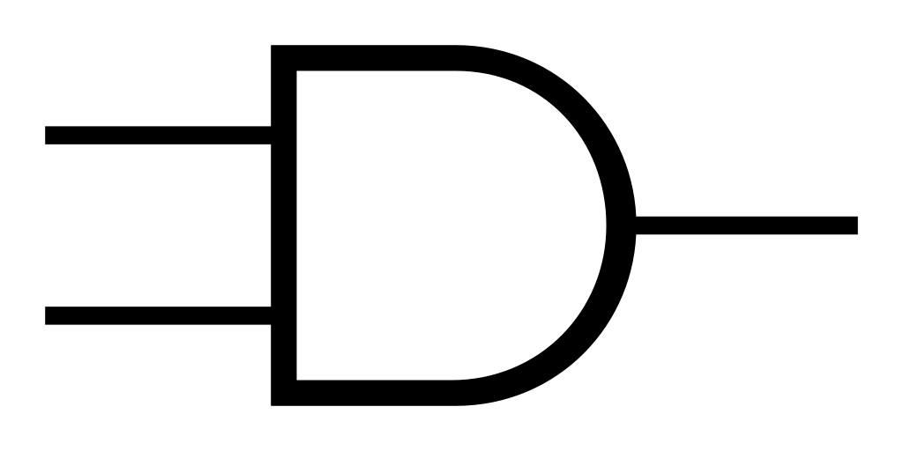
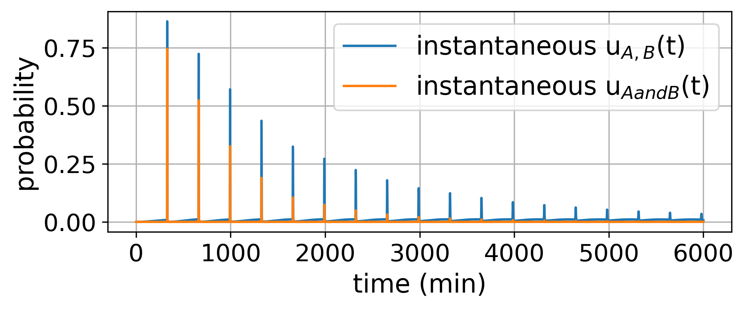
Phasing
Component A
Assigning an offset to the first rejuvenation greatly improves availability of the system.
If components all rejuvenate at the same time, system can undergo a global rejuvenation period.
Component B
AND
A
B
Paroli, Botarelli, Carnevali, Vicario ISSRE 2024

Slide 14
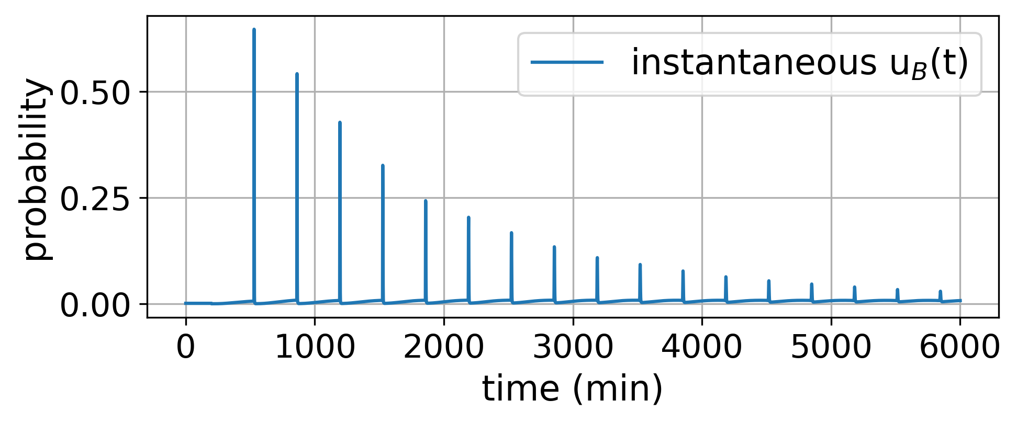
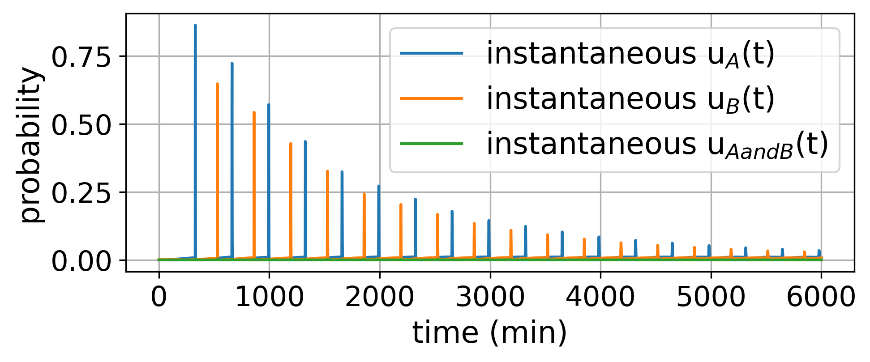
Phasing
Component A
Assigning an offset to the first rejuvenation greatly improves availability of the system.
If components all rejuvenate at the same time, system can undergo a global rejuvenation period.
If components have their rejuvenation phased by an offset, unavailablity is greatly diminished.
Component B
AND
A
B
Paroli, Botarelli, Carnevali, Vicario ISSRE 2024

Slide 15
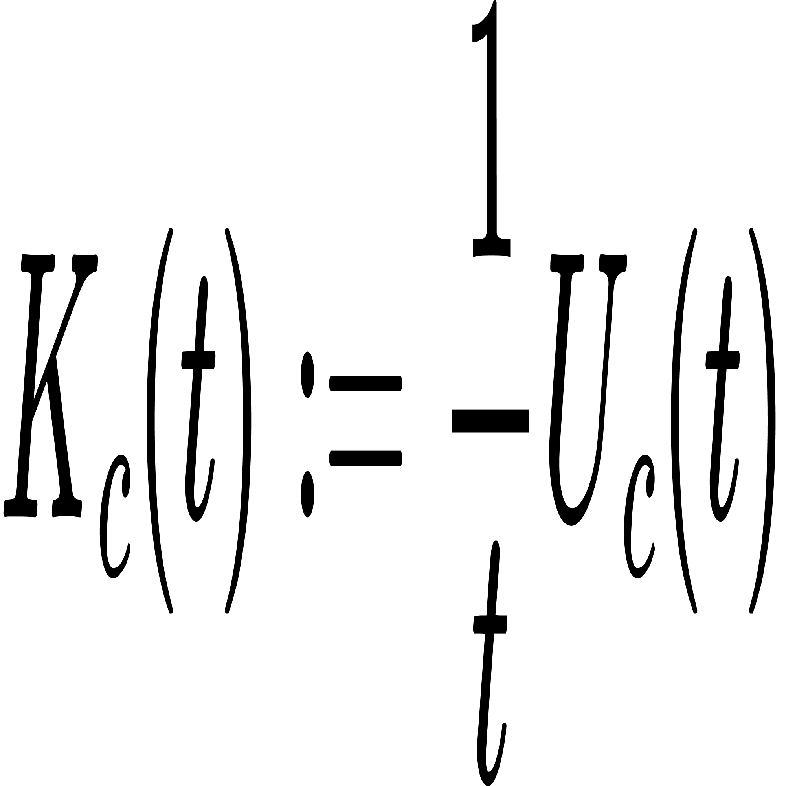
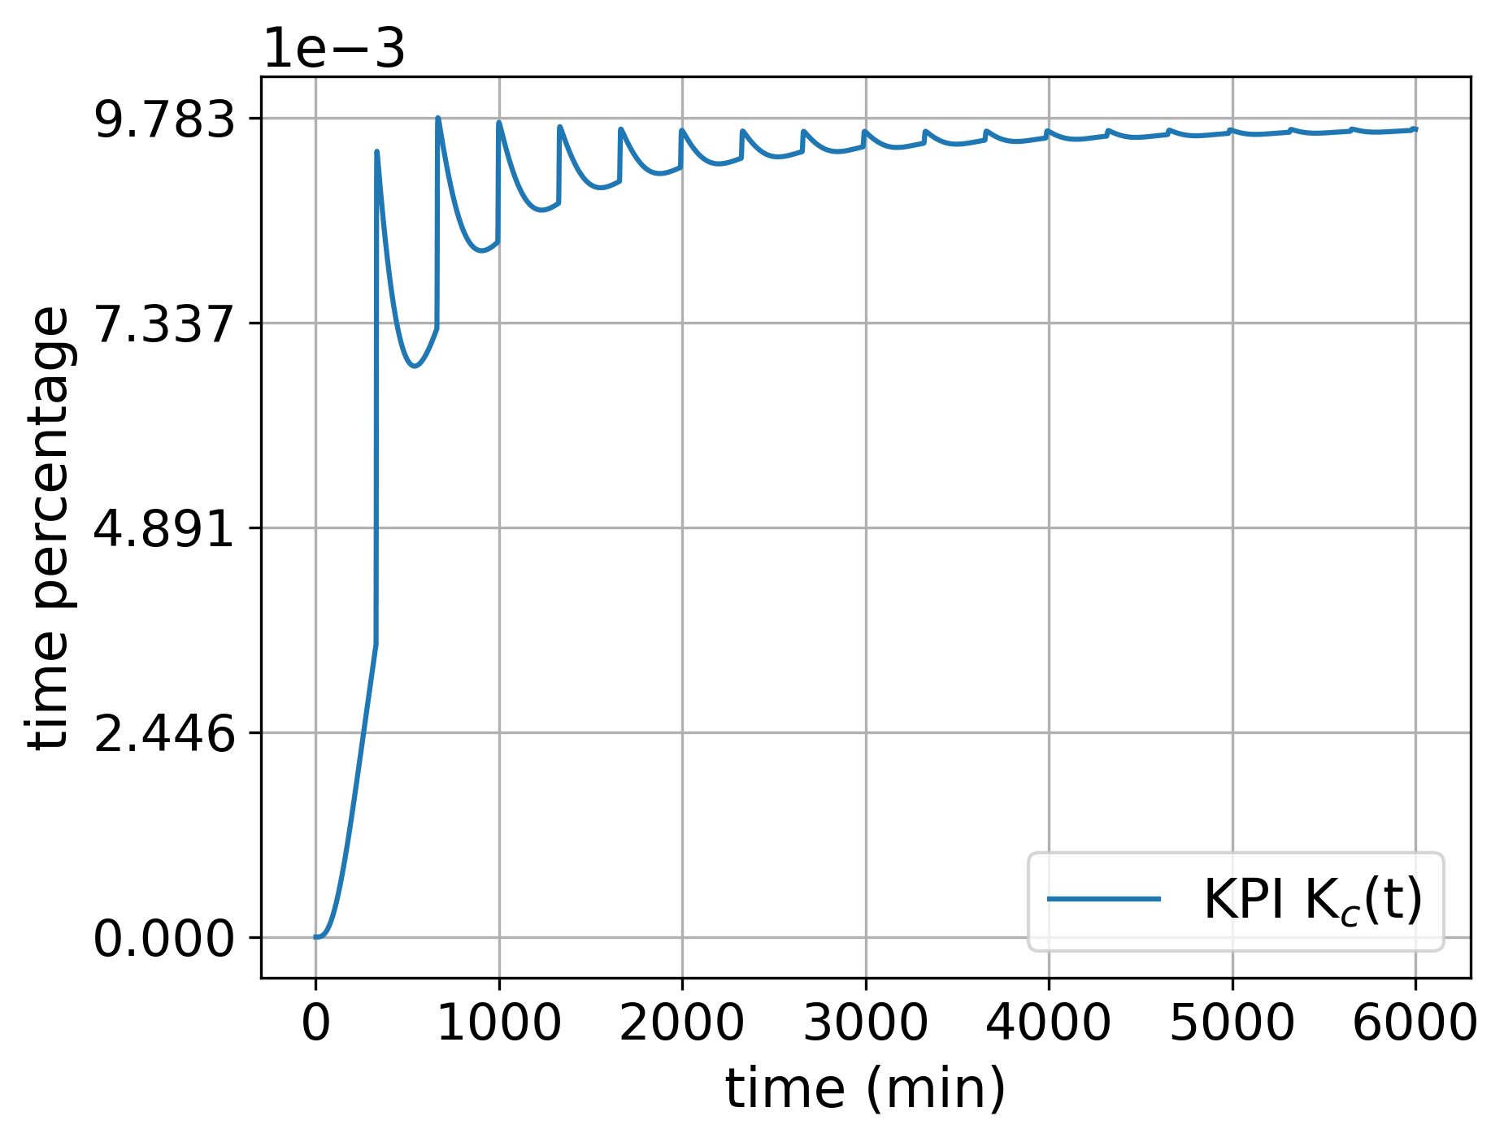
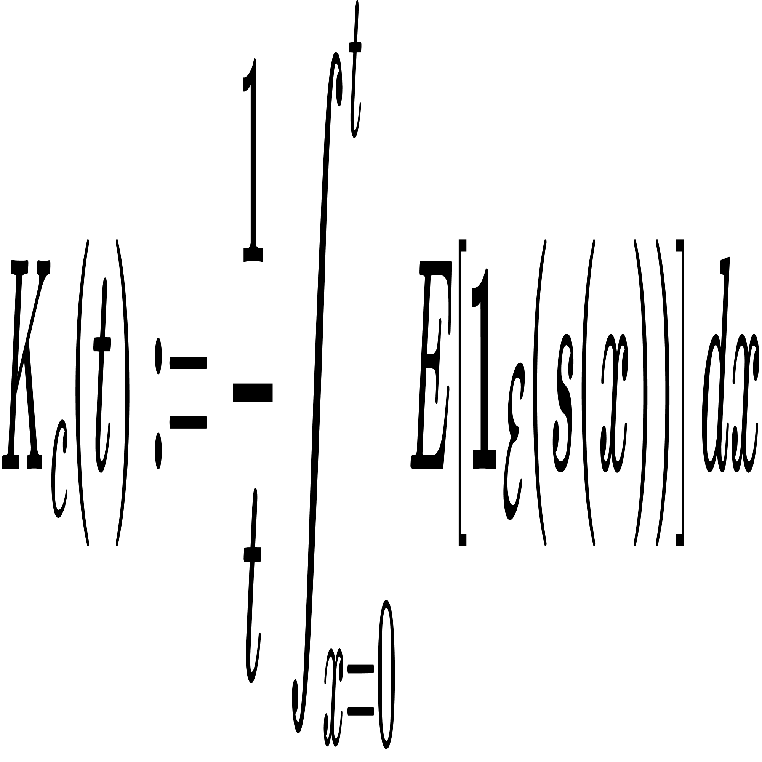
Key Performance Indicator
We consider K_{c}(t) where:
is the expected percentage of time during which the system has been unavailable in the interval
[0, t].
We aim at selecting values of the component offsets that minimize the system cumulative unavailability over time K(t).
Unavailability KPI of the component.
Paroli, Botarelli, Carnevali, Vicario ISSRE 2024

Slide 16
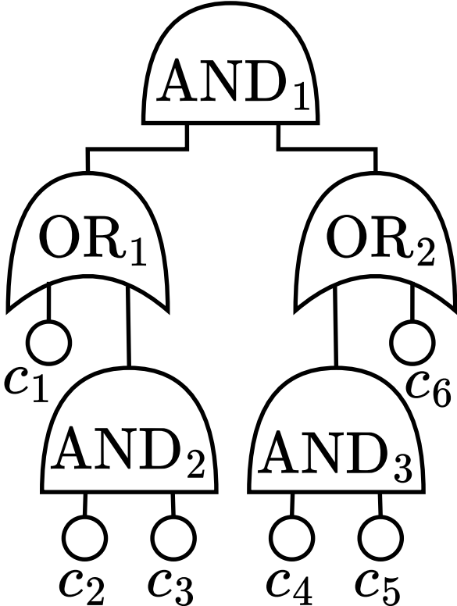
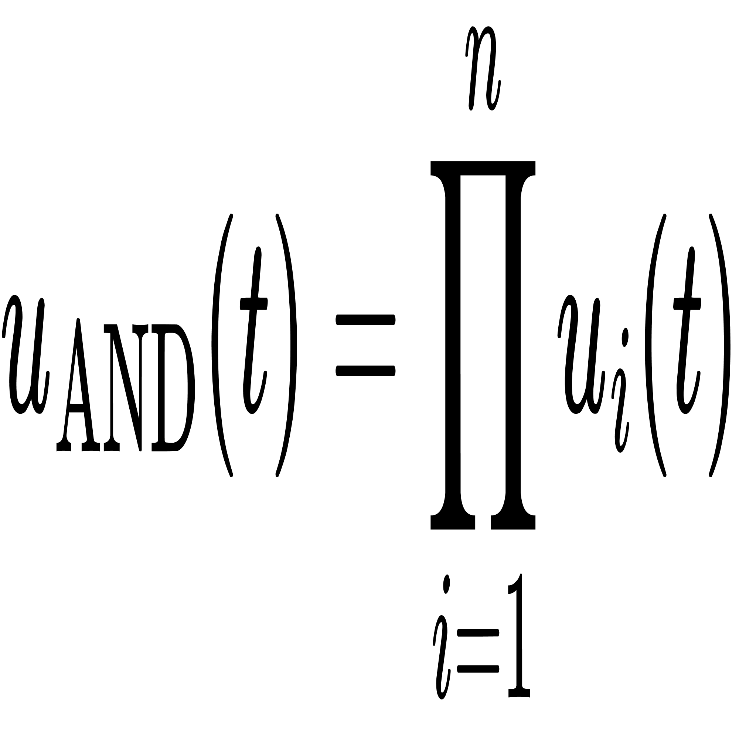
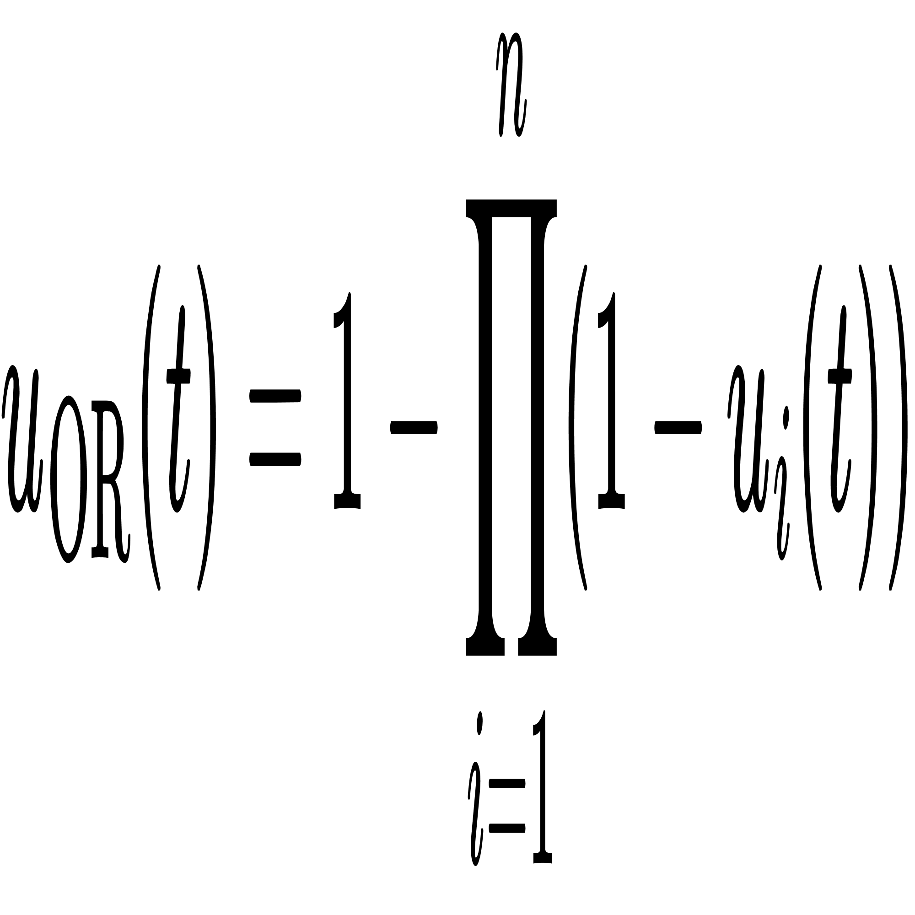
System Model
Objective: evaluate the availability (unavailablity) of the system under observation.
Consider a static fault tree with AND / OR logical gates, with components as leaves.
System unavailability can be naturally decomposed and computed for each component in isolation, and then combined through the boolean expression of the fault tree.
Static fault tree of a system with 6 components.
Paroli, Botarelli, Carnevali, Vicario ISSRE 2024

Slide 17
Optimization Algorithm
Two possible policies for offset assignment: uncoordinated and coordinated.
Uncoordinated approach : components will choose a random offset.
Coordinated approach: a centralized controller visits the fault tree, assigning offset based on an algorithm or policy.
Offset values between 0 and the duration of the rejuvenation period.
min
offset (0)
max
offset
Paroli, Botarelli, Carnevali, Vicario ISSRE 2024
Notes:
To ensure optimal rejuvenation, we calculated the rejuvenation offset for each component based on the system’s fault tolerance structure. Components with dependencies are staggered so that rejuvenation activities occur at times that minimize unavailability. For example, components that can take over for one another are rejuvenated at different times to avoid overlap

Slide 18
Optimization Algorithm
Uncoordinated approach : components will choose a random offset.
Each component chooses independently, without any coordination.
Components rejuvenate either at the same time or different times.
Doesn’t require a centralized controller.
min
offset (0)
max
offset
Paroli, Botarelli, Carnevali, Vicario ISSRE 2024
Notes:
To ensure optimal rejuvenation, we calculated the rejuvenation offset for each component based on the system’s fault tolerance structure. Components with dependencies are staggered so that rejuvenation activities occur at times that minimize unavailability. For example, components that can take over for one another are rejuvenated at different times to avoid overlap

Slide 19

Optimization Algorithm
Coordinated approach : a centralized controller visits the fault tree, assigning offset based on an algorithm.
Our heuristic is based on a top-down visit to determine the required offsets to be assigned, and a bottom-up visit to assign them.
OR
Components under OR gates are phased with the same offset.
Components under AND gates must be phased with different offsets.
AND
min
offset (0)
max
offset
Paroli, Botarelli, Carnevali, Vicario ISSRE 2024
Notes:
To ensure optimal rejuvenation, we calculated the rejuvenation offset for each component based on the system’s fault tolerance structure. Components with dependencies are staggered so that rejuvenation activities occur at times that minimize unavailability. For example, components that can take over for one another are rejuvenated at different times to avoid overlap

Slide 20
System Analysis
First tests have been performed on an example fault tree.
All components have the same model, with the same rejuvenation period, but must be assigned an offset.
Offsets are assigned through both coordinated (once) and uncoordinated (n times) methods.
System is then analyzed after each offset assignment.
Static fault tree of a system with 6 components.
Paroli, Botarelli, Carnevali, Vicario ISSRE 2024

Slide 21
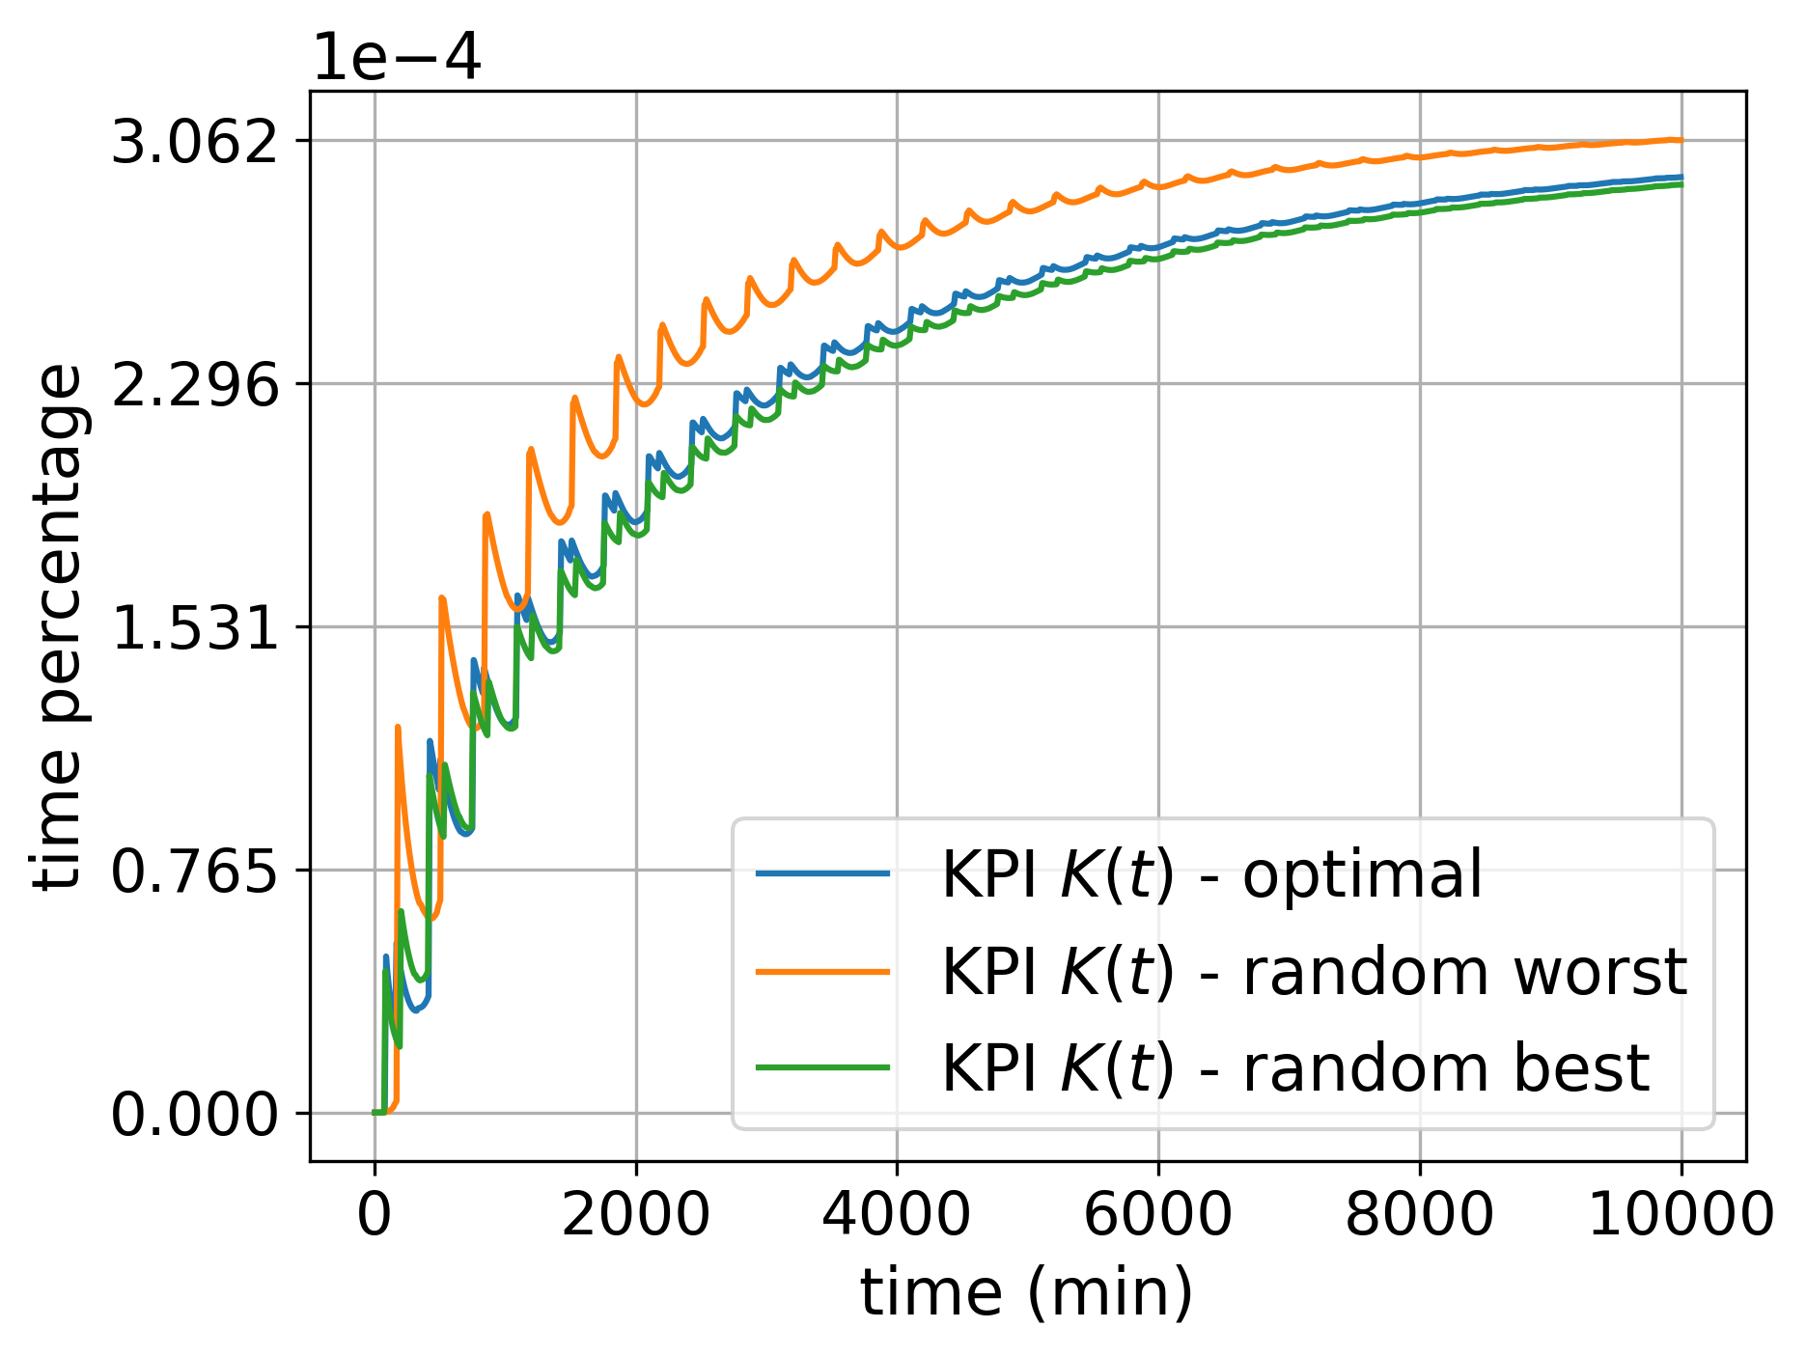
System Analysis
Unavailability KPI under coordinated and uncoordinated offset assignments.
Paroli, Botarelli, Carnevali, Vicario ISSRE 2024

Slide 22
System Analysis
random worst
KPI
optimal
random best
0
time
KPI behaviour under coordinated and uncoordinated offset assignments.
Unavailability KPI under coordinated and uncoordinated offset assignments.
Paroli, Botarelli, Carnevali, Vicario ISSRE 2024

Slide 23
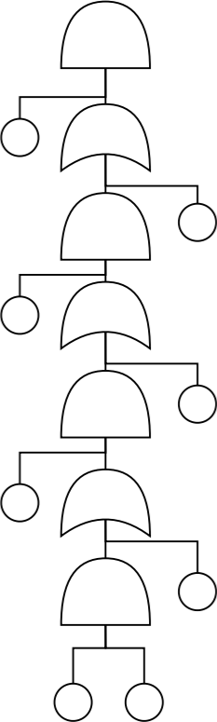
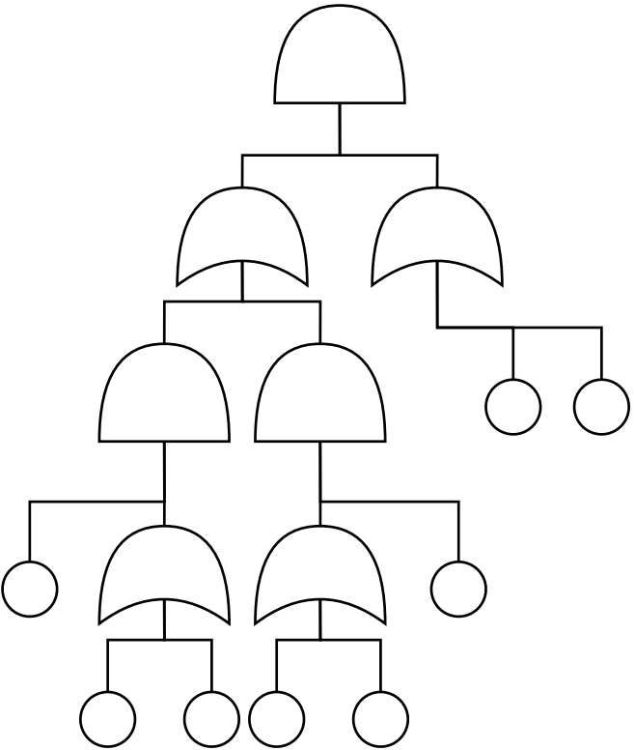
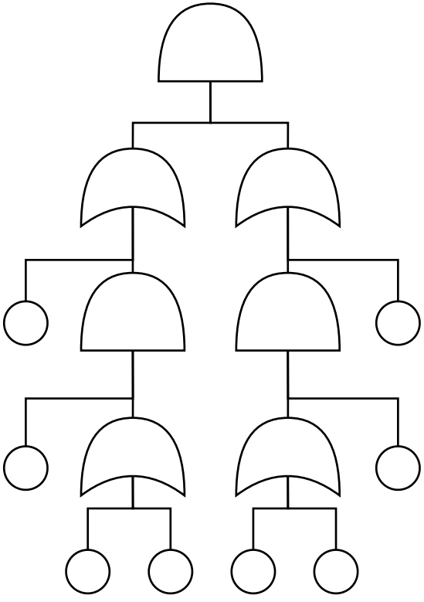
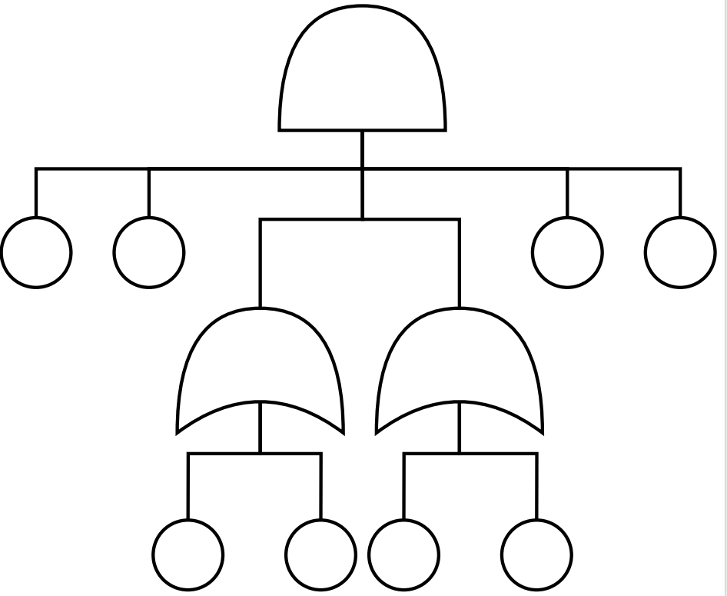
Results
Approach has been tested on randomly generated fault trees with varying number of components, using an ad-hoc algorithm to generate properly distributed fault trees.
Tests have been made on FTs with fixed shape:
Unbalanced FT
Balanced FT
Shallow FT
Deep FT
Paroli, Botarelli, Carnevali, Vicario ISSRE 2024
Notes:
Our experiments, conducted on randomly generated models, show that this coordinated rejuvenation strategy reduces system unavailability over time.

Slide 24
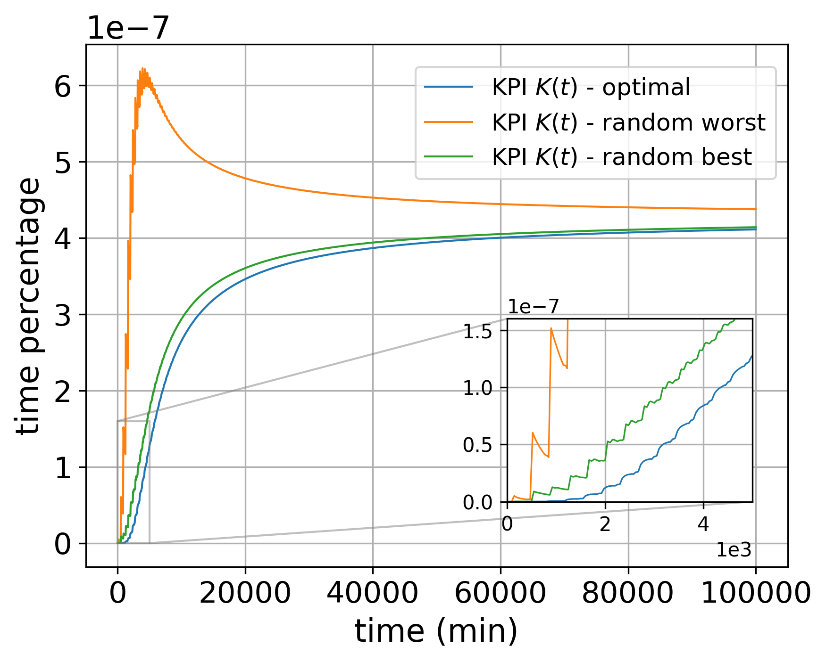
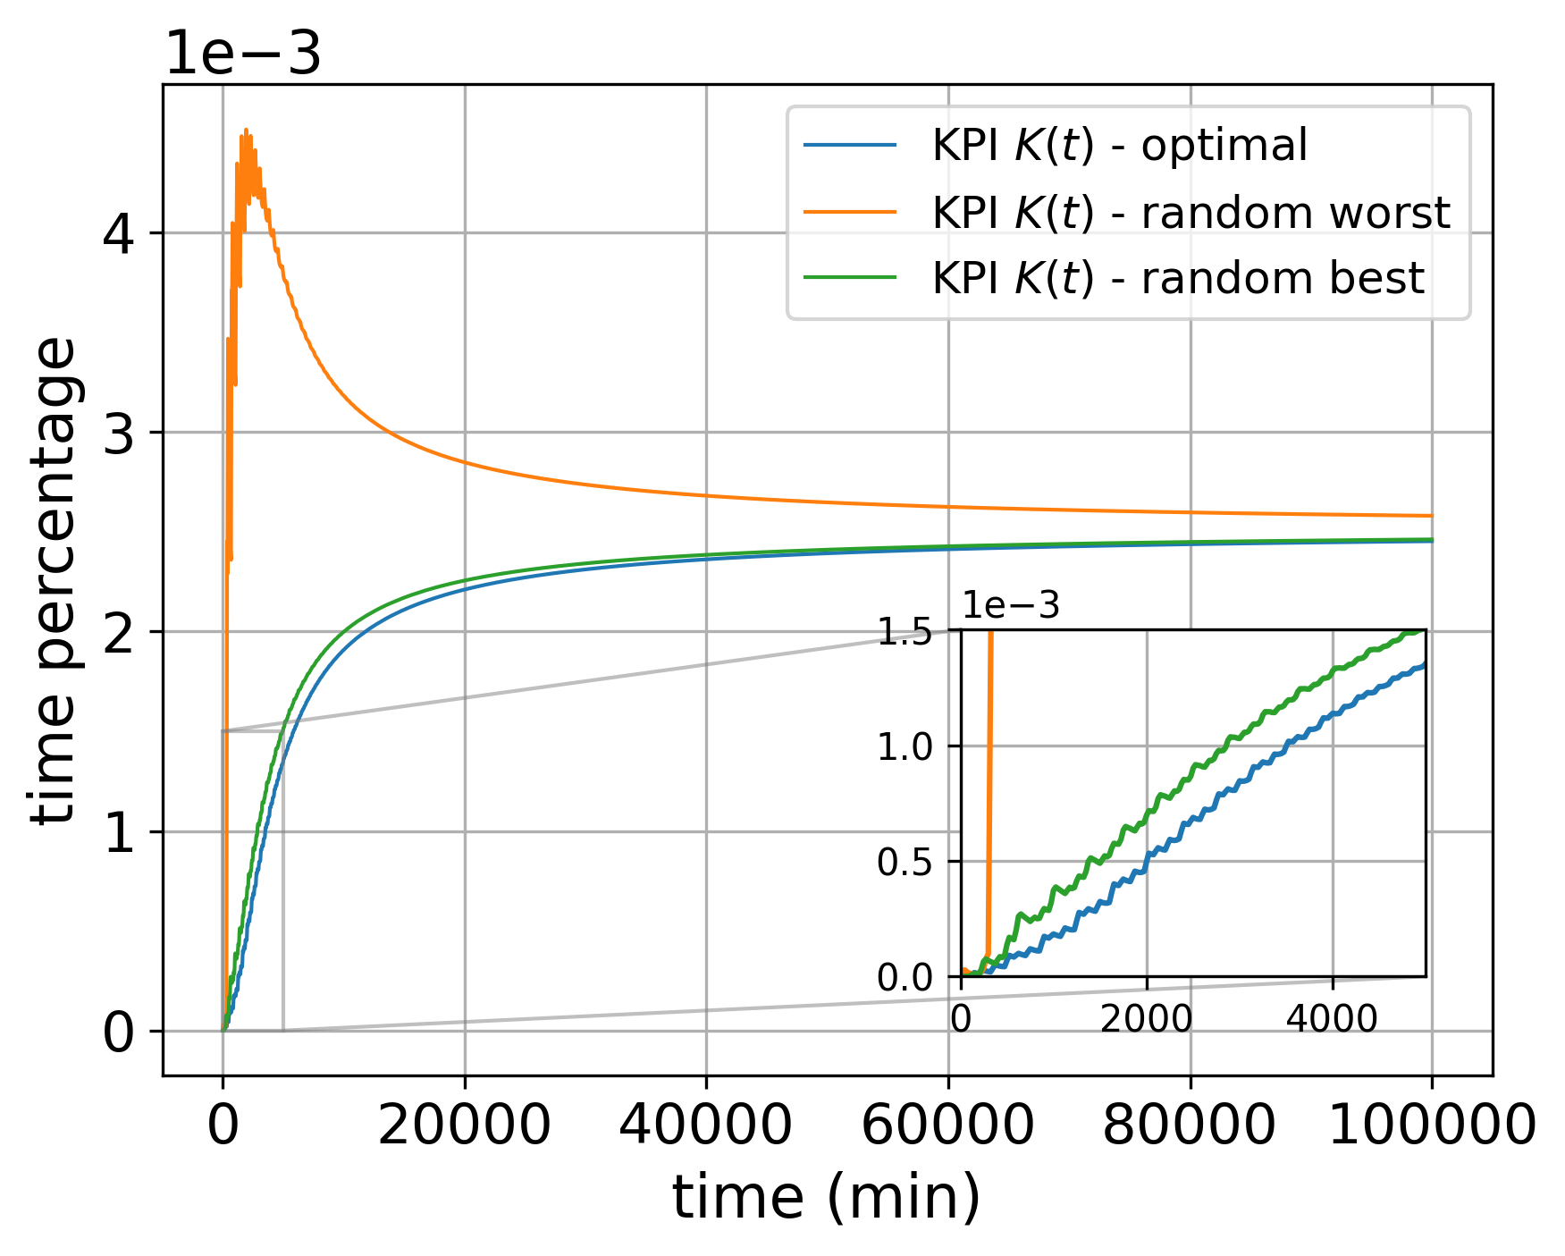
Balanced FT: Unavailability KPI under coordinated and uncoordinated offset assignments.
Unbalanced FT: Unavailability KPI under coordinated and uncoordinated offset assignments.
Paroli, Botarelli, Carnevali, Vicario ISSRE 2024

Slide 25
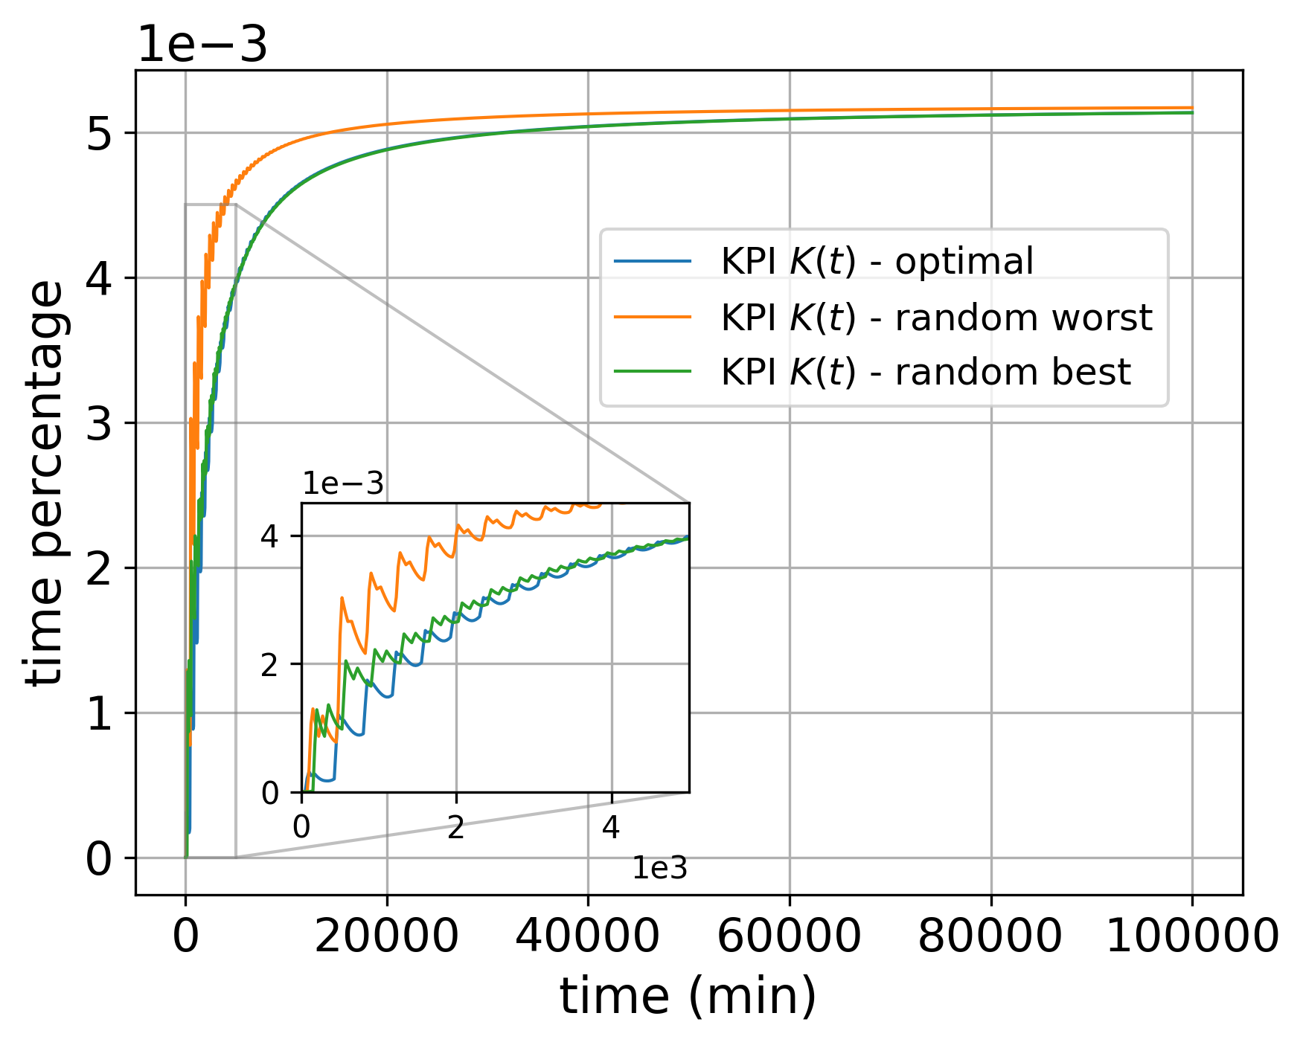
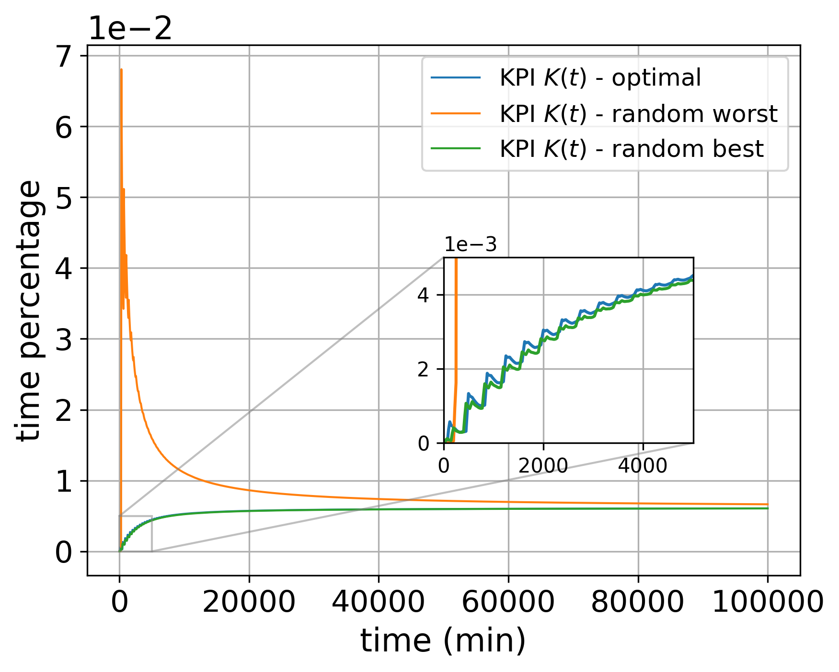
Deep FT: Unavailability KPI under coordinated and uncoordinated offset assignments.
Wide FT: Unavailability KPI under coordinated and uncoordinated offset assignments.
Paroli, Botarelli, Carnevali, Vicario ISSRE 2024

Slide 26
On Macro Rejuvenation
unavailability
KPI
Accumulation of failures
System accumulates “desynchronization” effects from optimal phasing due to component failures.
Drift from optimal synchronization reduces the effect of coordinated rejuvenation in the long term.
max
“desynchronization”
0
time
Unavailability over time
Paroli, Botarelli, Carnevali, Vicario ISSRE 2024

Slide 27
On Macro Rejuvenation
Adding a global rejuvenation mechanism to the system mitigates the problem of desynchronization.
global
rejuvenation
global
rejuvenation
global
rejuvenation
system desync
time
Software desynchronization, with global rejuvenation.
Paroli, Botarelli, Carnevali, Vicario ISSRE 2024

Slide 28
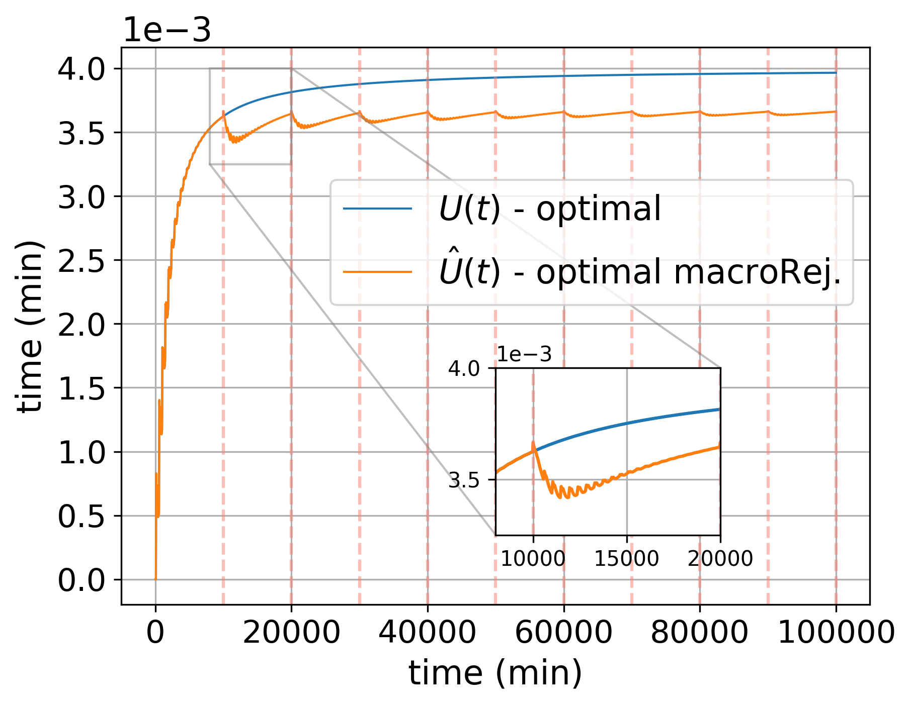

On Macro Rejuvenation
Global or macro-rejuvenation rewards higher availability to the system.
At the cost of higher complexity.
Macro-rejuvenation period and duration must be well parameterized.
Unavailability KPI of the system.
Paroli, Botarelli, Carnevali, Vicario ISSRE 2024

Slide 29
On Macro Rejuvenation
macro-regeneration
micro-rejuvenation
KPI
reward
macro-regeneration unavailability spike
micro & macro-rejuvenation
KPI
Zoom-in section of unavailability KPI graph.
Paroli, Botarelli, Carnevali, Vicario ISSRE 2024

Slide 30
Practical Implications
Consider a group of sensors covering two zones, with an aggregator collecting their data.
zone A
aggregator
All sensors in a zone must be available at all times.
zone B
System becomes unavailable if every zone and the aggregator aren’t available.
sensors
Representation of the network of sensors.
Paroli, Botarelli, Carnevali, Vicario ISSRE 2024
Notes:
A bit of imagine a network of IoT devices,, sensors in a distributed environment, which need to maintain uptime while rejuvenating their software periodically.
Our strategy would allow such systems to rejuvenate in coordination, allowing more uptime for the system.

Slide 31
Practical Implications / Consequences
unavailable
Network of sensors can be modeled as a component-based system.
AND
Logic relationships in regards to unavalaibility can be inferred from the system’s behaviour.
OR
OR
System can also apply a macro-rejuvenation policy.
aggregator
zone A
zone B
sensors
Unavalaibility fault tree of the network of sensors.
Paroli, Botarelli, Carnevali, Vicario ISSRE 2024
Notes:
In the paper, we illustrate an application of our approach. It’s an example where parameters are set with reference to a realistic case in the context of the IoT field:
imagine a network of IoT devices,, sensors in a distributed environment, which need to maintain uptime while rejuvenating their software periodically.
Our strategy would allow such systems to rejuvenate in coordination, allowing more uptime for the system.

Slide 32
Conclusions
First contribution: proposal of a coordinated offset assignment policy for component-based systems and compositional analysis to evaluate unavailability KPI by composition.
Second contribution: study on the applications of macro-rejuvenation mechanisms to component-based systems.
Evaluation of fault trees with more complex logical gates is ongoing.
We are also considering the use of dynamic fault trees.
We are researching on the concept of mixing time (time to steady state) for component-based systems.
Paroli, Botarelli, Carnevali, Vicario ISSRE 2024
Notes:
To conclude, our research offers a new way to approach software rejuvenation in component-based systems, focusing on minimizing cumulative system unavailability through an optimized scheduling strategy. This opens up possibilities for more robust and reliable systems, especially in fields that demand continuous uptime, like critical infrastructure and IoT networks.

Slide 33
Conclusions
Thank you
for the
attention.
Leonardo Paroli
leonardo.paroli@unifi.it
Software Technologies Lab,
University of Florence
First contribution: proposal of a coordinated offset assignment policy for component-based systems and compositional analysis to evaluate unavailability KPI by composition.
Second contribution: study on the applications of macro-rejuvenation mechanisms to component-based systems.
Evaluation of fault trees with more complex logical gates is ongoing.
We are also considering the use of dynamic fault trees.
We are researching on the concept of mixing time (time to steady state) for component-based systems.
Paroli, Botarelli, Carnevali, Vicario ISSRE 2024
Notes:
To conclude, our research offers a new approach to software rejuvenation in component-based systems, focusing on minimizing cumulative system unavailability through an optimized scheduling strategy.

Slide 34
Notes:
To conclude, our research offers a new approach to software rejuvenation in component-based systems, focusing on minimizing cumulative system unavailability through an optimized scheduling strategy.

Slide 35
Additional Material
Notes:
To conclude, our research offers a new approach to software rejuvenation in component-based systems, focusing on minimizing cumulative system unavailability through an optimized scheduling strategy.

Slide 36
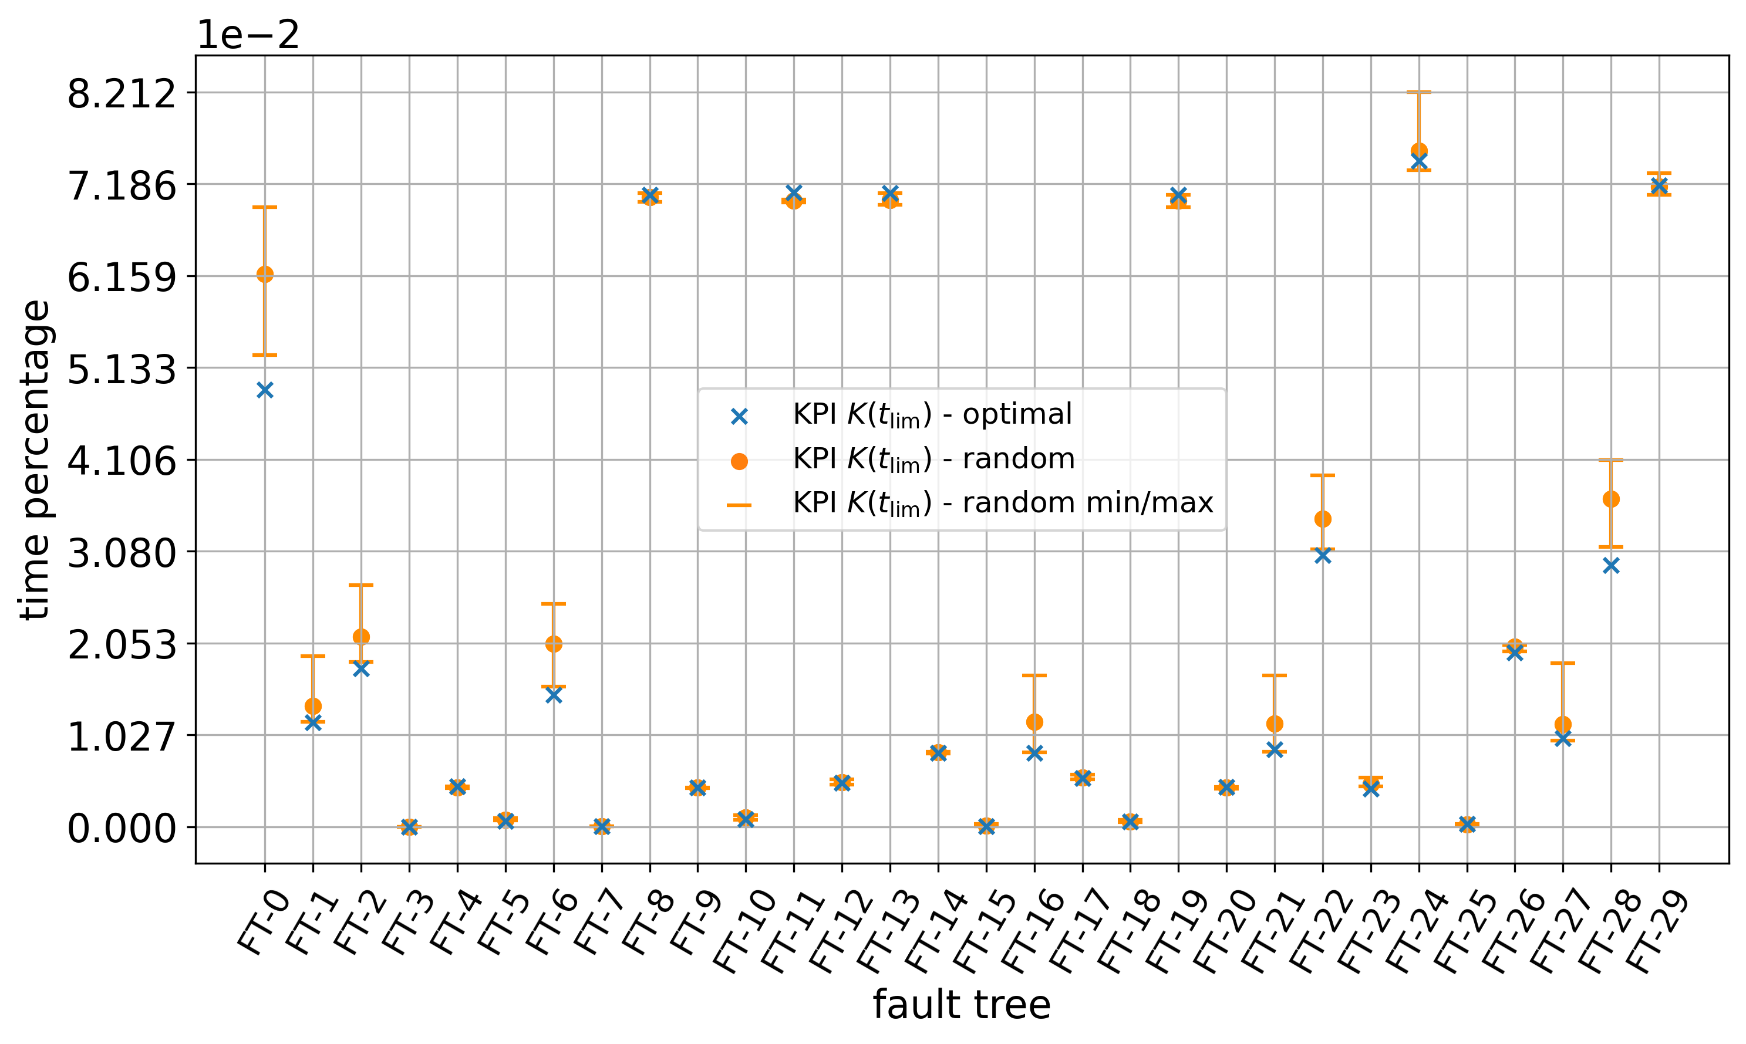
Additional Material
Paroli, Botarelli, Carnevali, Vicario ISSRE 2024

Slide 37
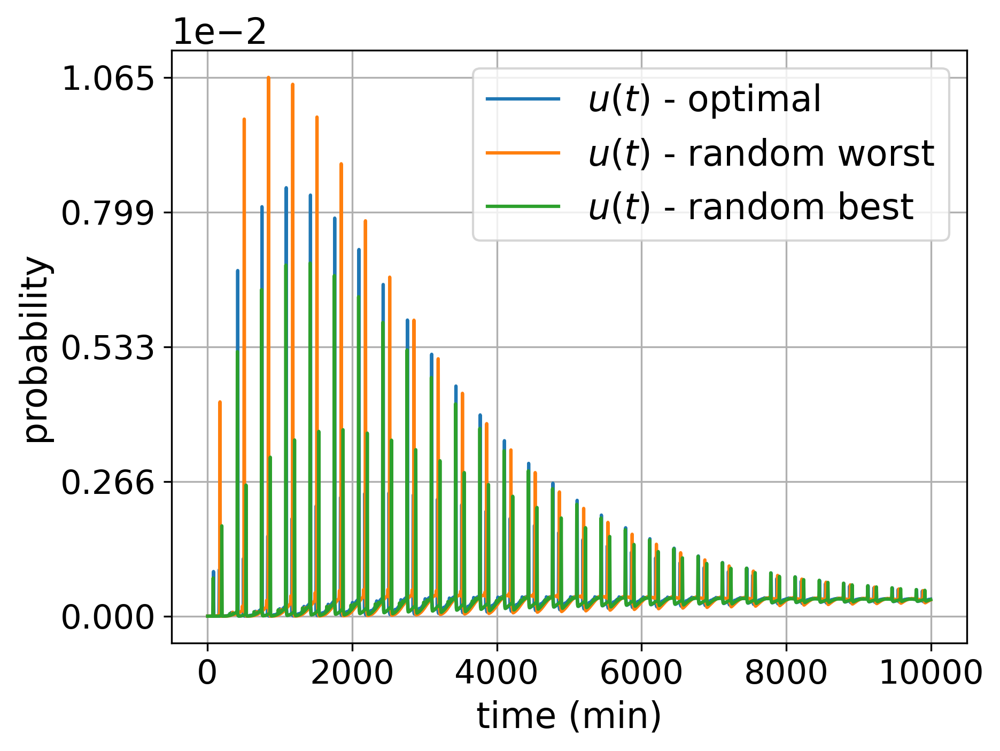
Additional Material
Paroli, Botarelli, Carnevali, Vicario ISSRE 2024

Slide 38
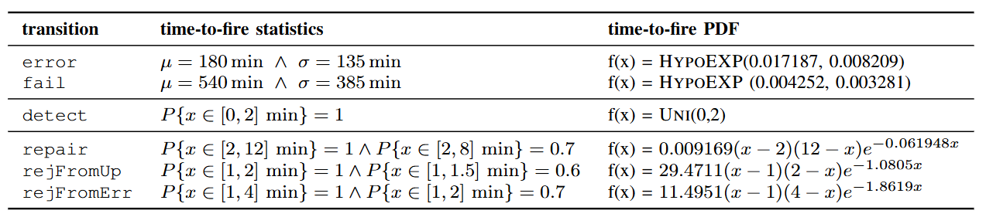
Additional Material
Paroli, Botarelli, Carnevali, Vicario ISSRE 2024

Slide 39
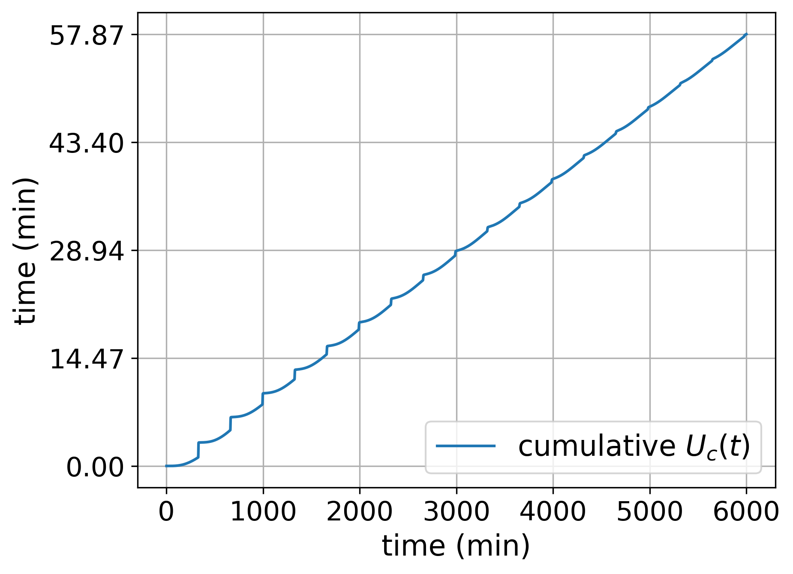
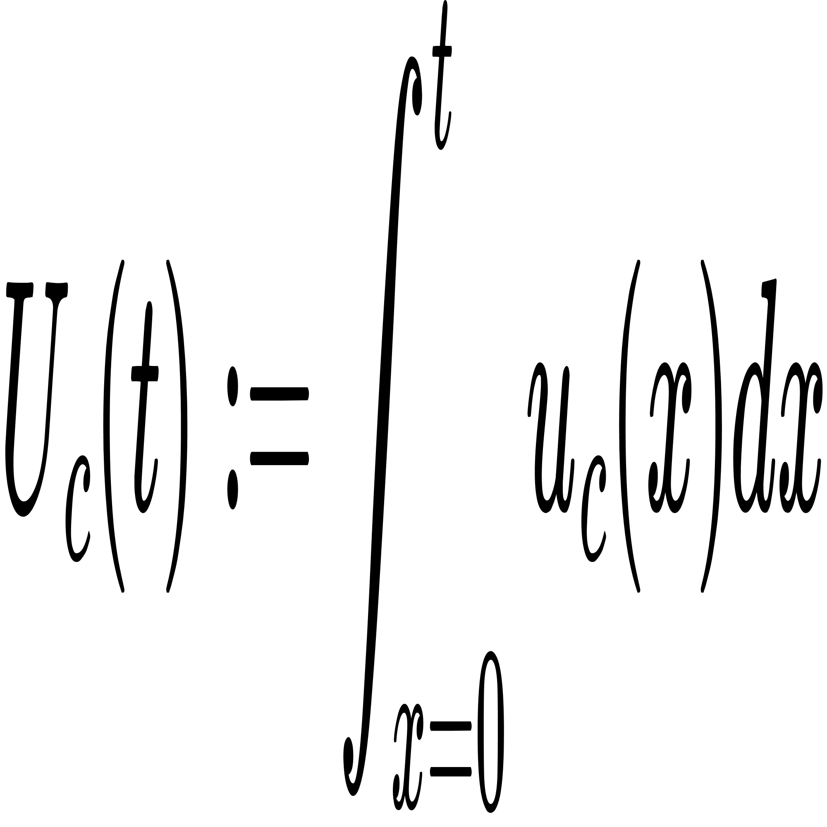
Key Performance Indicator
From instantaneous unavalability we can then consider:
which is the cumulative unavailability of the component.
Represents the total unavailability time of component up to time t.
Cumulative unavailability of the component.
Paroli, Botarelli, Carnevali, Vicario ISSRE 2024

